Slide 1

The Solar Energy
Dr . Raghad Al-journi
Electrical power and machine engineering department

Slide 2
2
PV Characteristics

Slide 3
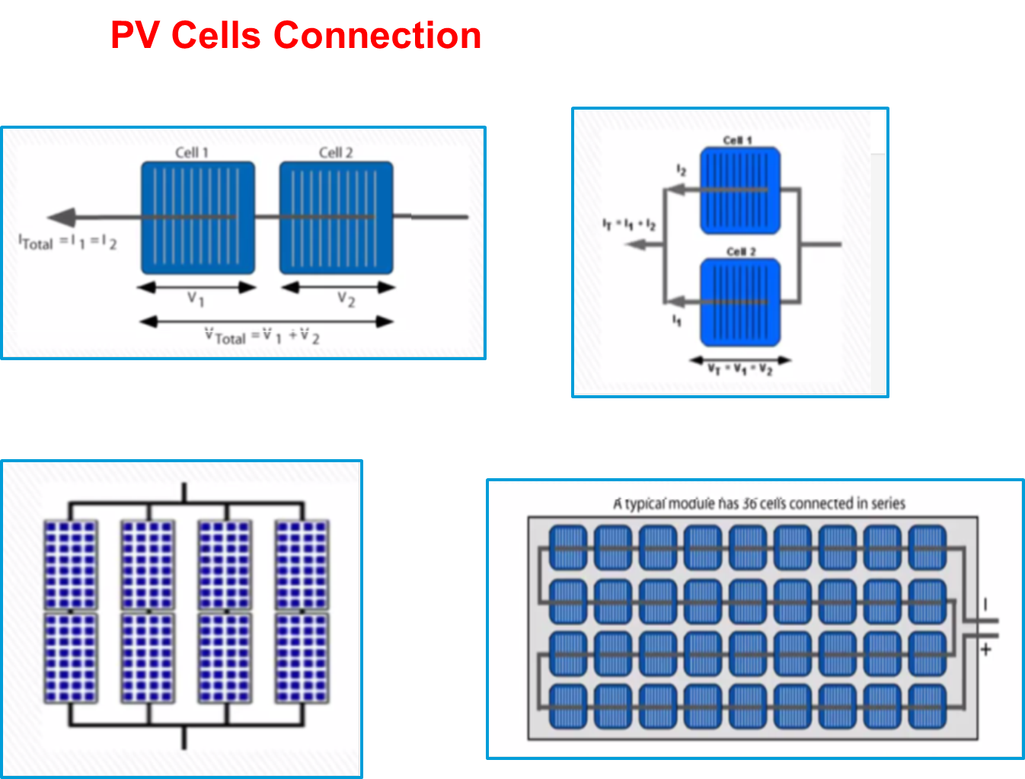
3

Slide 5
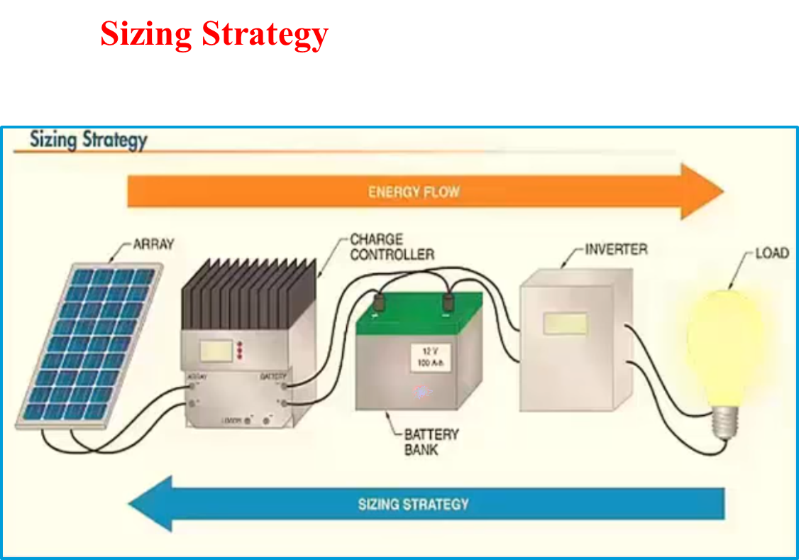
4

Slide 6
Types of solar PV systems
5
1-On – grid solar PV system

Slide 7
6
2-Off – grid solar PV system

Slide 8
7
3-Battery Backup system
Backup solar pv system

Slide 9
8
4-Portable solar PV system

Slide 10
10

Slide 11
11
Specification of any solar panels depends on the system:
1- Select the type of system required.
2- Select the loads required type.
3-Select the type and capacity of invertor .
4-Select the type and capacity of batteries.
5-Select the size of the panels necessary for the system.
6-Balance of system .

Slide 12
Maximum AC Power Requiement
12
Hours per day used | No. | Rated power(W) | Appliance
8 12 6 6 5 0.8 0.025 | 6 4 1 1 1 1 1 | 180 180 200 20 500 1500 1500 4080 W | 30w light 45w fan TV Satellite TV Refrigerator Washer Toaster

Slide 13
13

Slide 14
14

Slide 15
15

Slide 16
16

Slide 17
17

Slide 18
No of panel=4080/305 =13.3=14 panels
Connect 7S2P Pmax = 4270w (STC)
Vocmax = Voc(1+Tcmin -25) (∆voc/∆c))
Vmmin = Voc(1+Tcmax -25) (∆voc/∆c))
Tc=Ta +(NOCT-20)G/0.8
G=0 at sunrise
G=1 at noon
NOCT =47 Tcmax=50 +(47-20)1/0.8=84 C
Vocmax = 45.29(1+(-1-25)(-0.0311)=52V
Vm-min =35.77(1+(50-25)(-0.044))=26V
18

Slide 19
19
Tcmin =-1 C Tcmax =84 C
Voc max=52V Vmmin =26V
Voc max(t) =52*7=364V
Vm min(t) =26*7=182V
Inverter cost= $2299
Panels cost =$5104
Rack mount price =$1088
Wiring and protection =$500
Installation =$300
Total approx= $9291

Slide 20
Thank you for your attention！

